Slide 1

Human Computer Interaction-HCI
Welcome to the Exciting World of HCI
Jayashree R
Department of Computer Science and Engineering

Slide 2

Human Computer Interaction-HCI
Introduction
Jayashree R
Department of Computer Science and Engineering

Slide 3
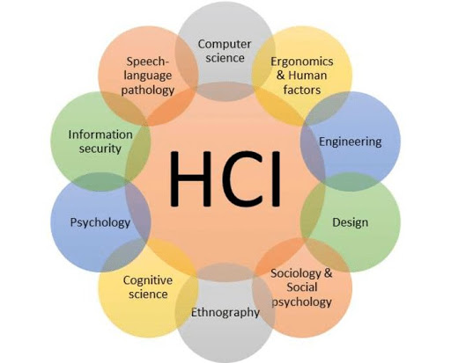
Human Computer Interaction-HCI
What is HCI?
HCI is a fascinating multidisciplinary field focusing on the design of computer technology , in particular, the interaction between humans and computers

Slide 4
Human Computer Interaction-HCI
Why HCI in CSE
Every engineering discipline includes the study of breakdowns and the design of improved / or new solutions that address those breakdowns

Slide 5
Human Computer Interaction-HCI
Why HCI in CSE
Understanding how and why human interaction breaks down is fundamental to designing better computing systems.
This study must include computer scientists, as we are the ones creating the technology

Slide 6
Human Computer Interaction-HCI
HCI is an extension of Traditional CS Disciplines
We design, scale, and evaluate computing systems for particular tasks (e.g., parallel programming, network routing)
HCI incorporates humans into the computing system Humans as an additional constraint Any computer system must be designed taking into account - the physical constraints of the machine (e.g., processor speed, networking capabilities) - the human physical and mental constraints (e.g., attention, memory) - (should we add, social level constraints?)

Slide 7
Human Computer Interaction-HCI
Course Objectives
Familiarize the psychology underlying user-interface and usability design guidelines keeping in mind human behavioral and perceptual capabilities and limitations that affect interface design.
Familiarize with the basic principles of Goal-directed user interface design and standard patterns and key modelling concepts involved in Visual interface design for software interfaces.
Apply development methodologies and lifecycle models for building user interfaces and prototyping in user interface design and how to test them.
Familiarize with the impact of usable interfaces in the acceptance and performance utilization of information systems.
Highlight the importance of working in teams and the role of each member within an interface development phase.

Slide 8
Human Computer Interaction-HCI
Takeaway?
Course Outcomes:
Develop and use a conceptual vocabulary for analysing human interaction with software: affordance, conceptual model, feedback.
Explain how user-cantered design complements other software process models
Use lo-fi (low fidelity) prototyping techniques to gather, and report, user responses
Define a user-centred design process that explicitly takes account of the fact that the user is not like the developer or their acquaintances
Choose appropriate methods to support the development of a specific UI

Slide 9
Human Computer Interaction-HCI
Syllabus
Unit-1: INTRODUCTION
The Human: I/O channels – Memory – Reasoning and problem solving; The computer: Devices – Memory – processing and networks; Interaction: Models – frameworks – Ergonomics – styles – elements – interactivity- Paradigms.
12 Hours Unit-2:DESIGN & SOFTWARE PROCESS
12 Hours
Interactive Design basics – process – scenarios – navigation – screen design – Iteration and prototyping. HCI in software process – software life cycle – usability engineering – Prototyping in practice – design rationale. Design rules – principles, standards, guidelines, rules. Evaluation Techniques – Universal Design.

Slide 10
Human Computer Interaction-HCI
Syllabus
Unit-3:MODELS AND THEORIES
10 Hours
Cognitive models –Socio-Organizational issues and stake holder requirements –Communication and collaboration models.
Unit-4:TASK ANALYSIS 10 Hours
Task Analysis-Dialog notations and design, Models of the system, Modelling rich interaction
Unit-5:OUTSIDE THE BOX:
12 Hours
groupware, ubiquitous computing, augmented realities, hyper text,
multimedia and World Wide Web

Slide 11
Human Computer Interaction-HCI
Prerequisite and Literature
Pre-requisite Courses: None.
Text Book :
Human Computer Interaction , 3rd Editions , Dix A., Finlay J., Abowd G. D. and Beale R., Pearson Education, 2005.
Reference Book(s):
B. Shneiderman; Designing the User Interface, Addison Wesley 2000 (Indian Reprint)
About Face: The Essentials of Interaction Design by Alan Cooper, Robert Reimann, David Cronin. Christopher Nooessel, 4th Edition, WILEY
Don't Make Me Think, Revisited: A Common Sense Approach to Web and Mobile Usability (3rd Edition) Paperback by Steve Krug (Author), 3rd Edition
The Design of Everyday Things (Revised and Expanded Edition) by Don Norman

Slide 12
Human Computer Interaction-HCI
Evaluation Policy (Tentative)
ISA-1: conducted for 40 marks brought down to 10
ISA 2: conducted for 40 marks brought down to 10
Assignment/Project : 20 Marks
ESA: 60 Marks

Slide 13
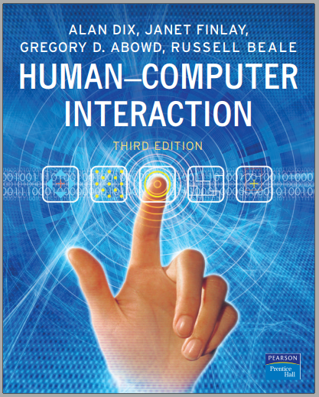
Human Computer Interaction-HCI
Text Book

Slide 14

Human Computer Interaction
Why HCI??

Slide 15
THANK YOU
Jayashree R
Department of CSE,
jayashree@pes.edu
+91 9845897074

